Slide 1
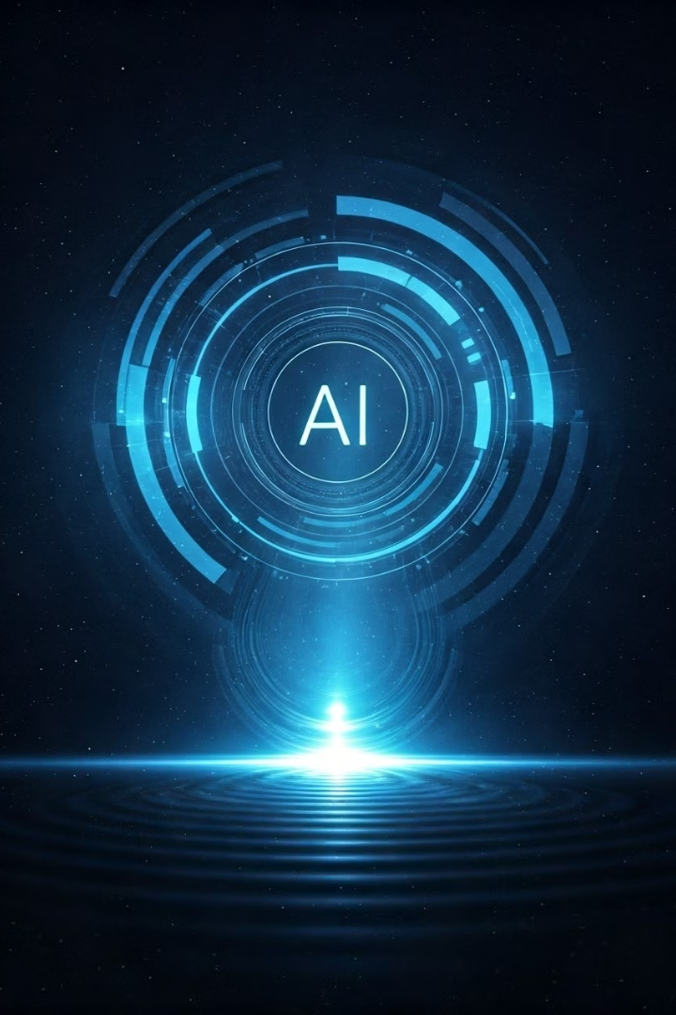
PVGʼs college of Science and Commerce.
Presentation on
“Artificial Intelligence in Astrophysics”
by
Aditya Kunjir, Pushkaraj Gaikwad, Prajwal Pawar
Department of Computer Science
2024-25

Slide 2
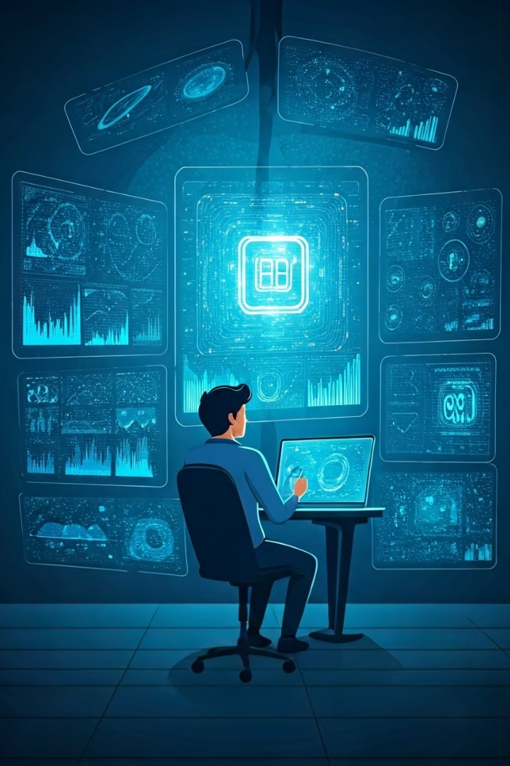
Introduction to the Research Problem
1
Purpose
Explore AI's role in solving complex challenges in astrophysics.
2
Background
Astrophysics generates vast amounts of data, and AI is used to analyze astronomical datasets and automate the identification of celestial objects.
3
Presented by
Pushkaraj S. Gaikwad, Department of Computer Science

Slide 3
Current Research Landscape
AI in Astronomy
Challenges
Galaxy Classification
Handling massive datasets
Exoplanet Detection
Improving pattern recognition and data accuracy
Gravitational Wave Analysis

Slide 4
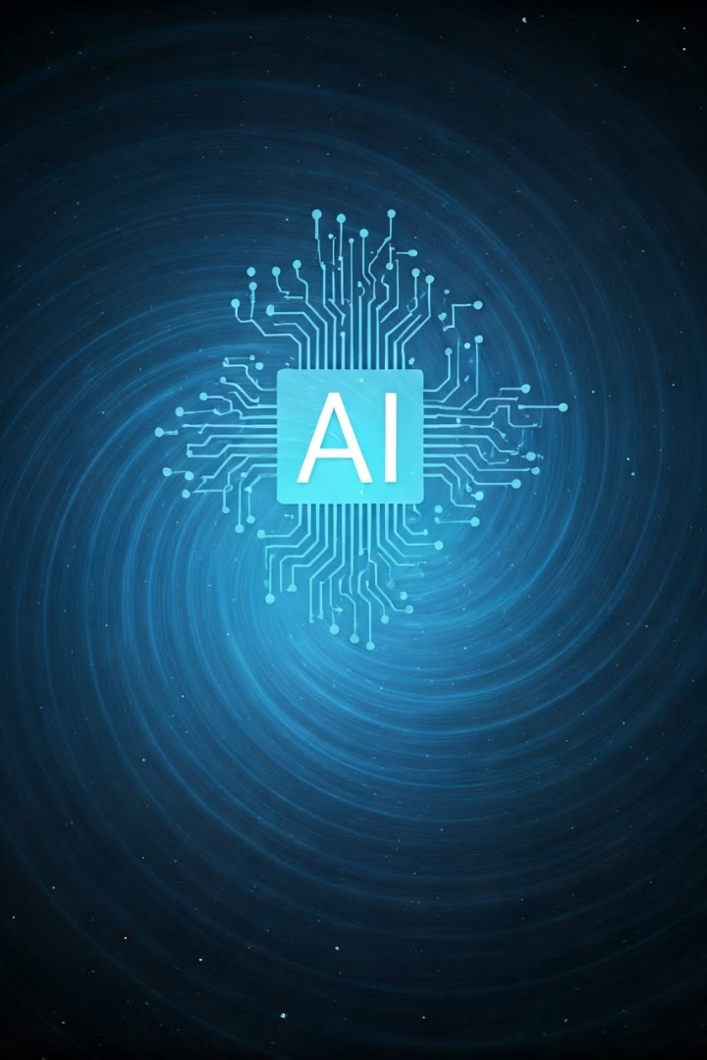
Research Problem Definition
Problem Statement
How can AI and ML improve the accuracy and efficiency of data analysis in astrophysical research?
Key Objective
To classify galaxies, detect exoplanets, and analyze gravitational wave data more effectively using AI.

Slide 5
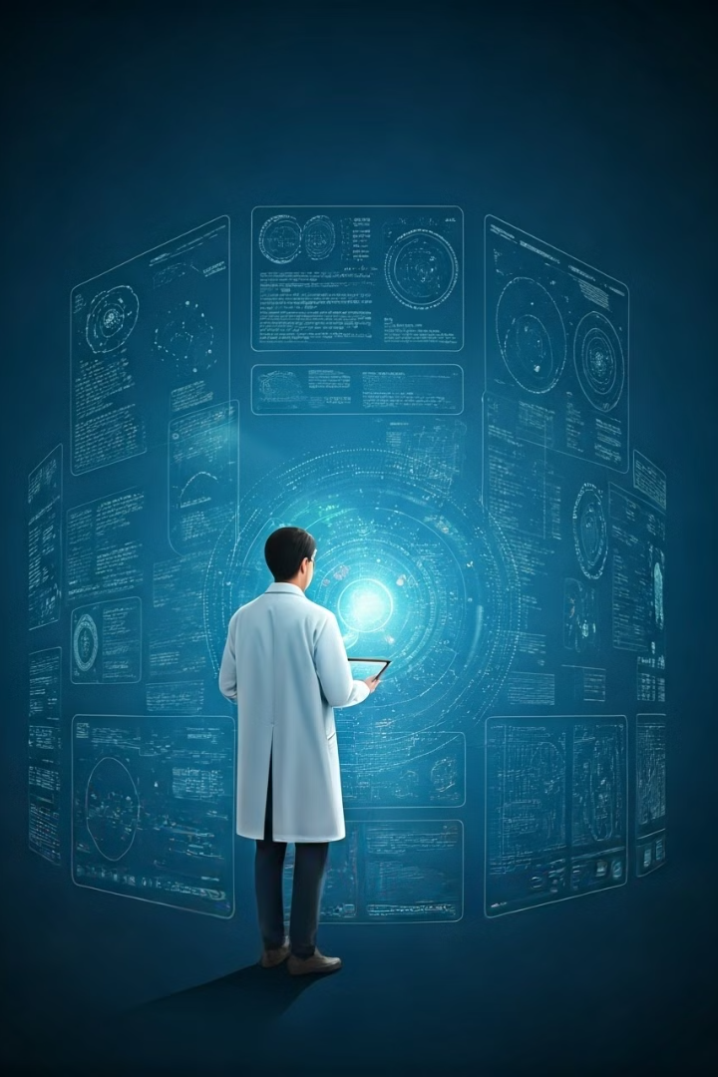
Methodology and Approach
1
Data Collection
Astronomical datasets from space missions and sky surveys.
2
Data Preprocessing
Cleaning, normalizing, and labeling datasets.
3
Feature Engineering
Use deep learning models like CNNs for galaxy image classification.

Slide 6
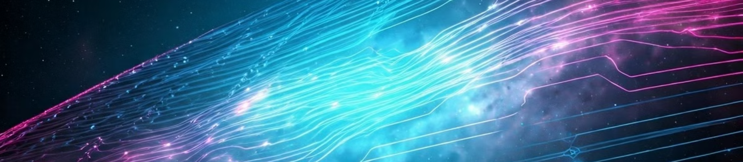
AI Model Implementation
ML Algorithms
Deep Learning
Support Vector Machines, Random Forests, and k-NN for classification.
CNNs for image analysis, RNNs/LSTMs for time-series data analysis.

Slide 7
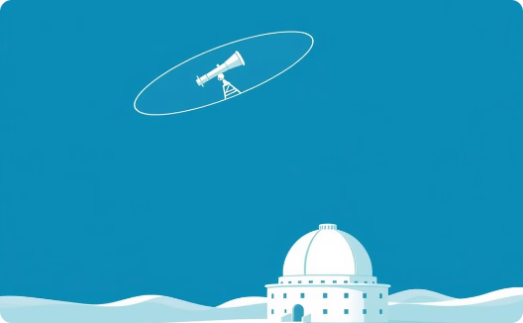
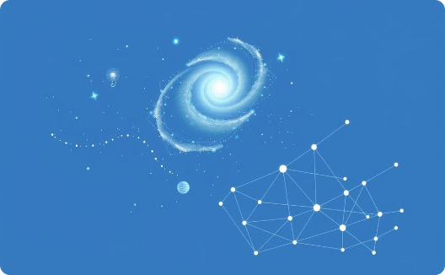
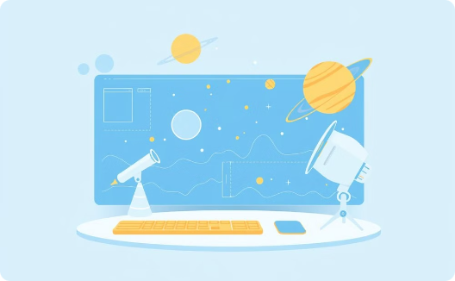
System Design and Architecture
Data Flow
AI Processing
Analysis
Collect astronomical data
Train AI models
Analyze and classify data in real time
Core Components: AI for data interpretation, pattern recognition, and decision-making.

Slide 8
Advantages and Challenges of AI in Astrophysics
Advantages
Challenges
Handling Massive Data: Faster processing of large datasets.
Data Bias: Inaccurate or incomplete training data.
Pattern Recognition: AI excels at detecting subtle patterns.
Computational Costs: High resource requirements for AI training.
Real-Time Analysis: Enables quick responses to cosmic events.
Domain Expertise: Need for collaboration between astrophysicists and AI experts.

Slide 9
References
References
• "Deep Learning in Astronomy" by Barak Zackay, Lea Katz, and Eran Ofek Published in: Publications of the Astronomical Society of the Pacific (PASP), • "AI-assisted Discovery of Strong Gravitational Lensing Systems" by Lan Wang, Alireza Pourrahmani, and others Published in: Monthly Notices of the Royal Astronomical Society (MNRAS), 2020. • "Exoplanet Detection using Machine Learning Methods" by David Armstrong, L. Giles, and others Published in: Monthly Notices of the Royal Astronomical Society (MNRAS), 2018. • "Galaxy Morphology Classification with Deep Learning" by Cecilia Nord, Robert R. Carrasco Kind, and others Published in: Astronomy & Astrophysics, 2019. • "Artificial Intelligence in Gravitational Wave Detection" by Rory Smith, Erik Katsavounidis, and others Published in: Physical Review Letters, 2020.

